Slide 1
SR2I 208. Project of the Filiere
Malicious Messages Detector Based on Neural Network
Supervisor: Jean-Philippe MONTEUUIS
Guodong SUN
Liang WANG
24 June, 2019

Slide 2
Content
Introduction
Datasets -- Preprocessing
Neural Network based Detector
Malicious Detector
Classifier
Model Test
Conclusion

Slide 3
Introduction

Slide 4
Background
VANET (figure)
Data type:
BSM

Slide 5
Type of Attackers
-Constant : Attacker report a false position which is a constant value.
-Constant Offset : Attacker transmits a fixed offset added to the real position.
-Random : Attacker sends a random position inside the simulation area.
-Random Offset : Attacker sends a random position within a rectangle around the vehicle.
-Eventual Stop : Attackers behave normally for some time and then attacks by transmitting the same position repeatedly.

Slide 6
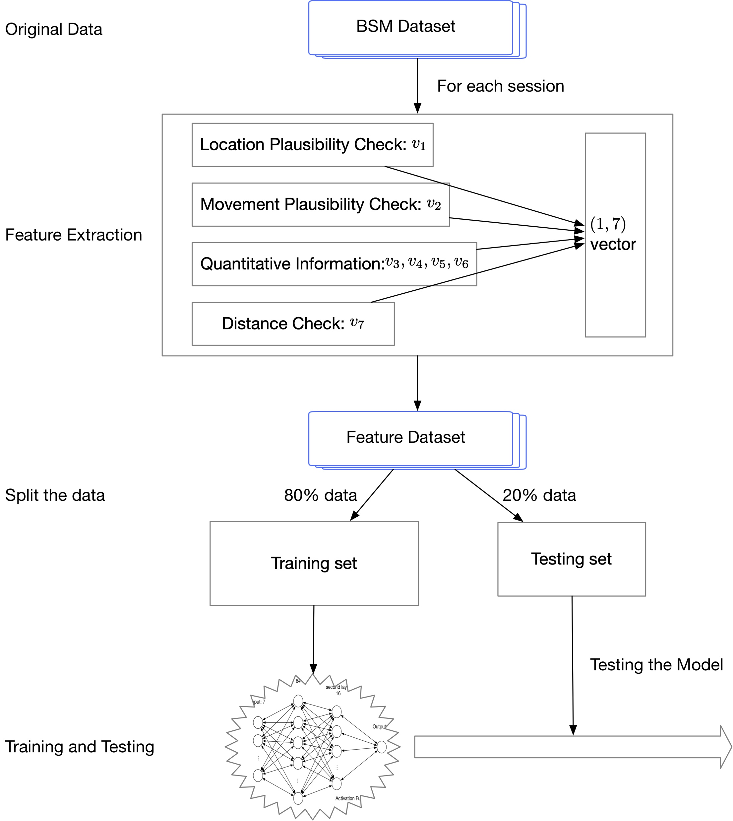
Step 1
Step 2
Work Flow
(for both models)
Step 3
Step 4

Slide 7
Datasets -- Preprocessing

Slide 8
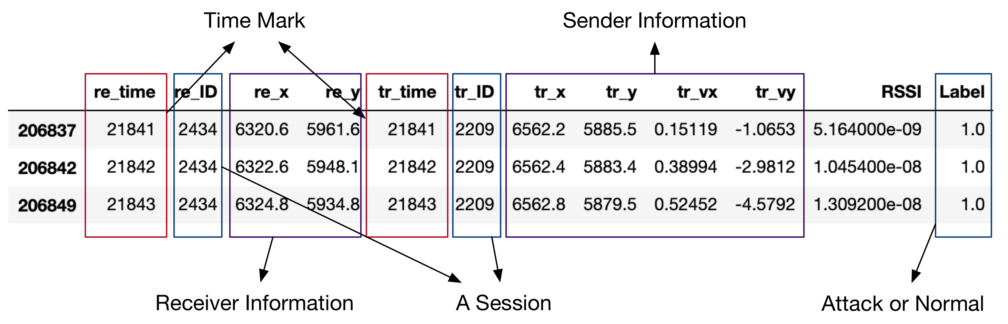
A BSM
A communication session between a sender and a receiver.
A session is whether ‘Normal’ or ‘Attack’.
Fig: a typical session

Slide 9
Statistics of Dataset
There are five datasets, each consists of a type of attacks and normal data.
Our first mission is to identify the abnormity from each dataset.
Table: statistics of the datasets
 | # Rows | # Sessions | # Attack | # Normal
Type 1 | 387516 | 30588 | 0.3143 | 0.6857
Type 2 | 387516 | 30588 | 0.3143 | 0.6857
Type 4 | 387634 | 30642 | 0.3449 | 0.6551
Type 8 | 386747 | 30596 | 0.2551 | 0.7449
Type 16 | 386834 | 30601 | 0.2964 | 0.7036
[1] R. W. van der Heijden, T. Lukaseder, and F. Kargl, “VeReMi: A Dataset for Comparable Evaluation of Misbehavior
Detection in VANETs,” in Security and Privacy in Communication Networks, vol. 254, no. 2, Cham: Springer, Cham, 2018,
pp. 318–337.

Slide 10
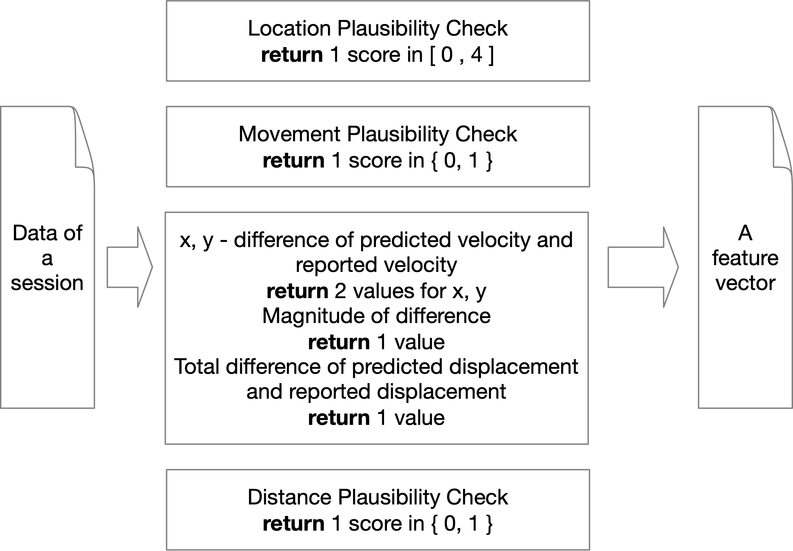
Obtaining
Feature vectors

Slide 11
Splitting the datasets
We split the datasets into two parts: 80% for training and 20% for testing
Table: Statistics of split data (feature vector) set.
 | Sessions | Training datasets |  | Testing datasets
 |  | Attack | Normal | Attack | Normal
Type 1 | 30588 | 0.3122 | 0.6877 | 0.3228 | 0.6771
Type 2 | 30588 | 0.3142 | 0.6857 | 0.3146 | 0.6853
Type 4 | 30642 | 0.3456 | 0.6543 | 0.3414 | 0.6585
Type 8 | 30596 | 0.2582 | 0.7417 | 0.2424 | 0.7575
Type 16 | 30601 | 0.2982 | 0.7017 | 0.2888 | 0.7111
All data | 153015 | 0.3047 | 0.6952 | 0.3060 | 0.6939

Slide 12
Neural Network based Detector

Slide 13
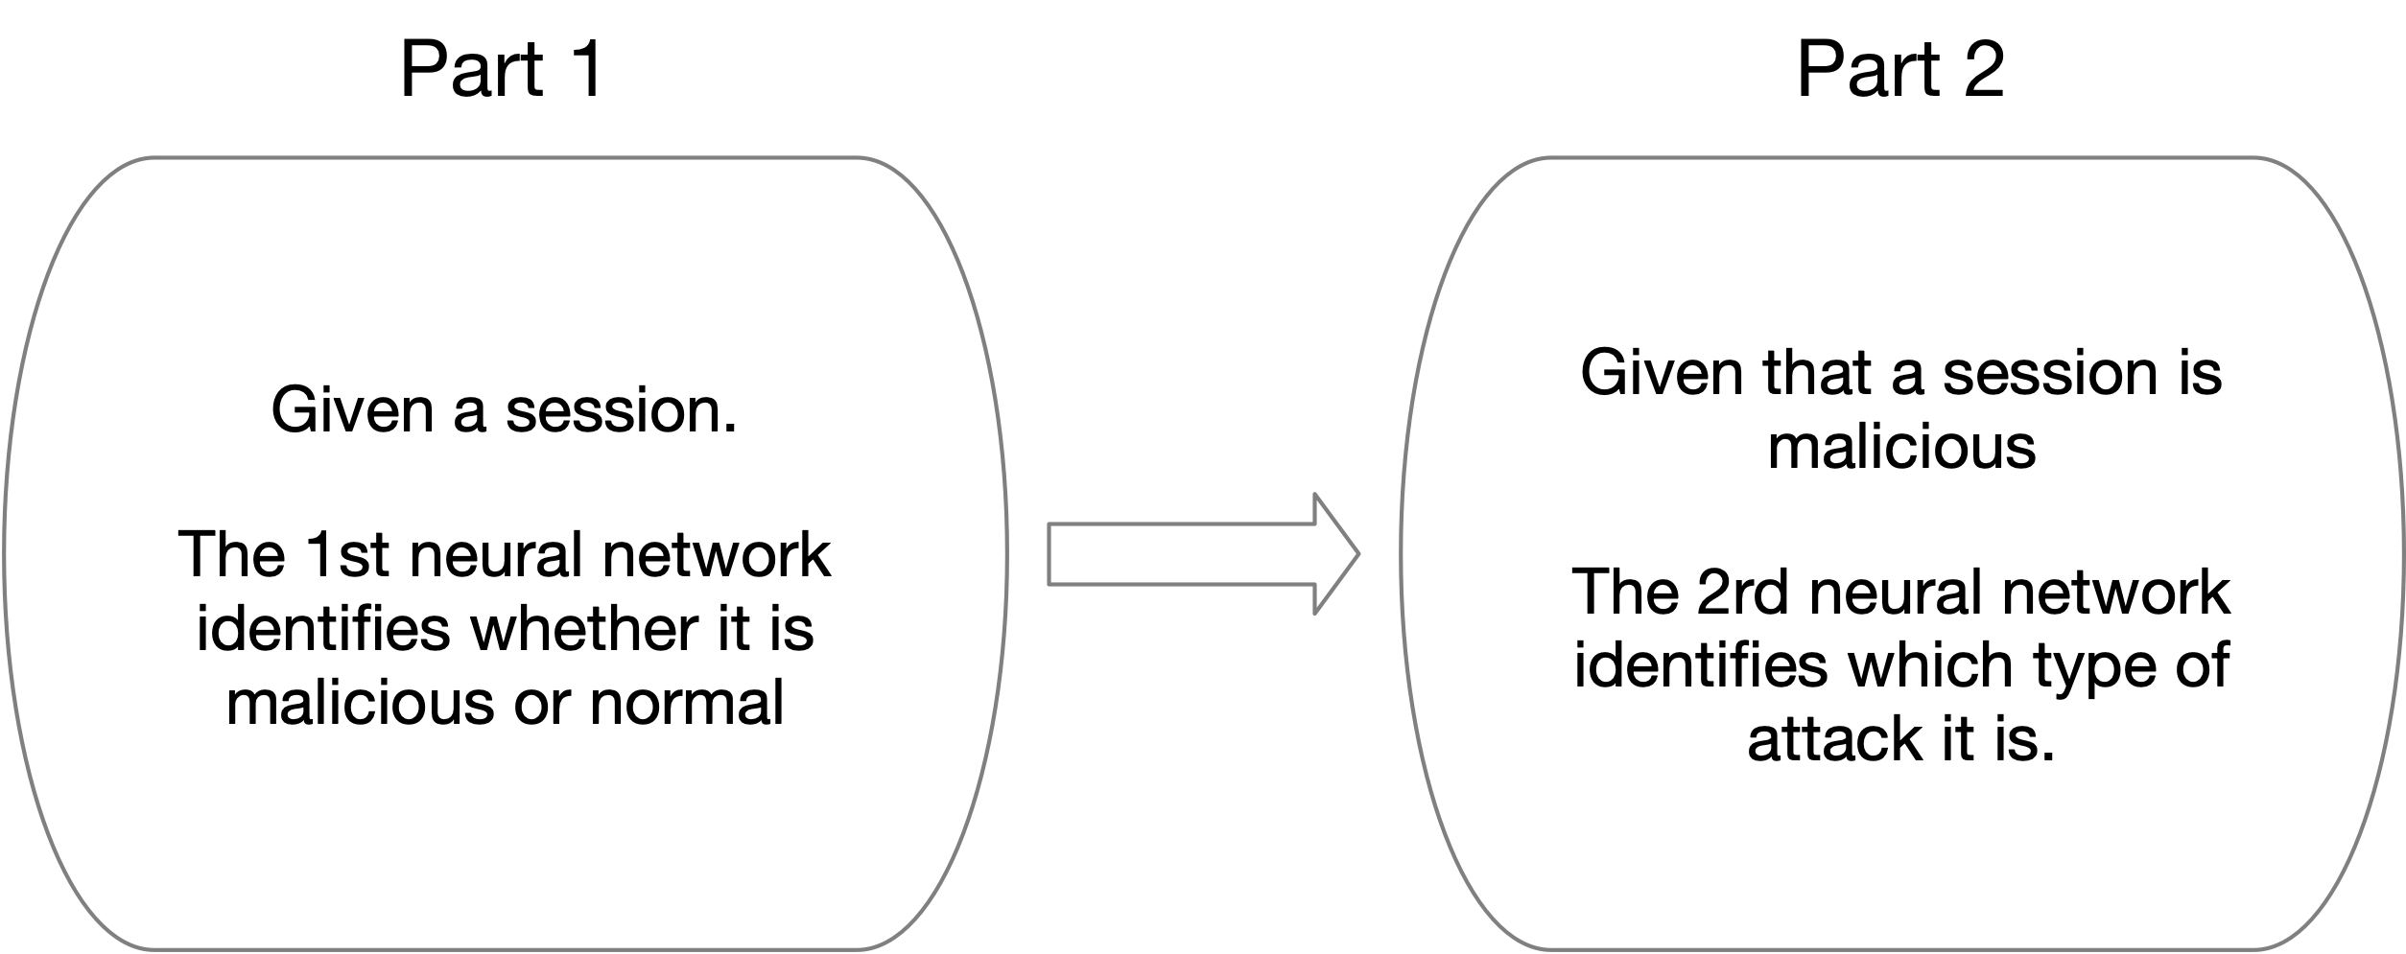
Our Neural Network Model

Slide 14
Part 1: Abnormity Detector

Slide 15
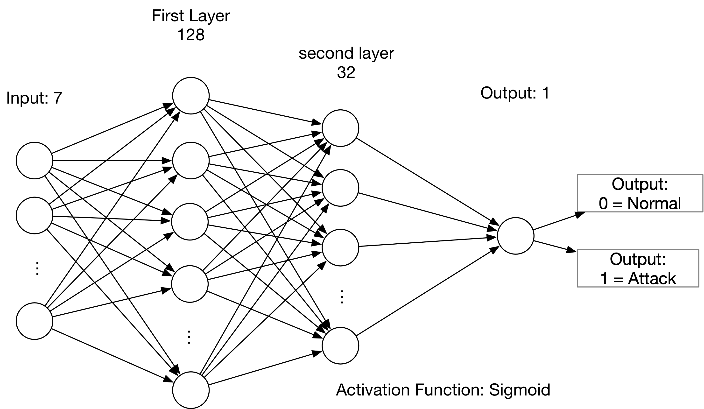
Fig: structure of neural network based detector.
Detector Model
Loss function: Mean_Absolute_Error
Optimizer: RMSprop

Slide 16
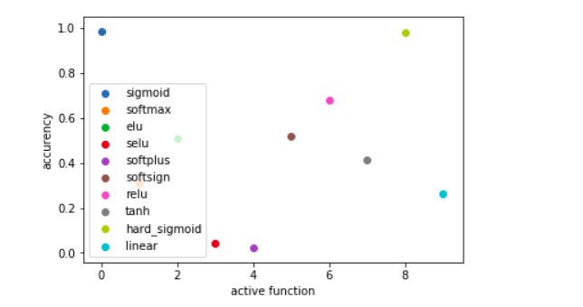
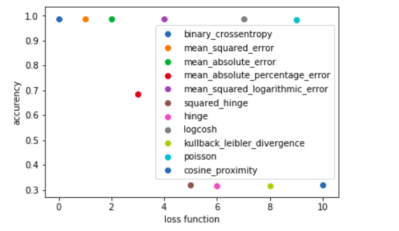
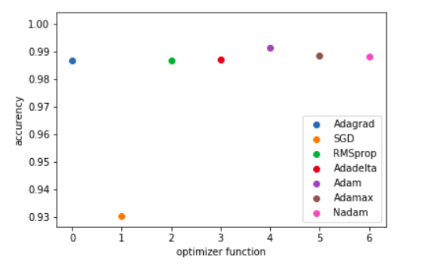
Chose of parameters
According to the expirement, we find best parameters in active function, loss function and optimizer function.

Slide 17
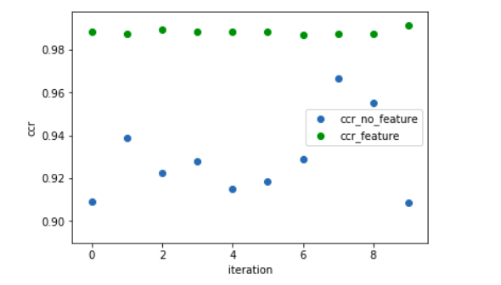
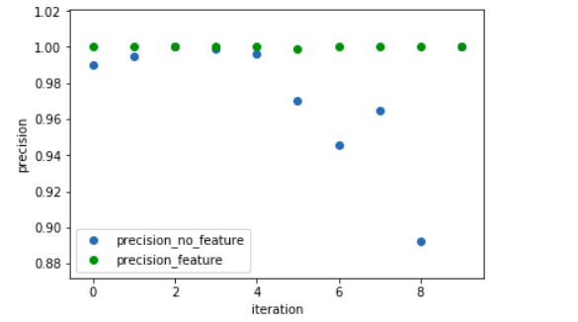
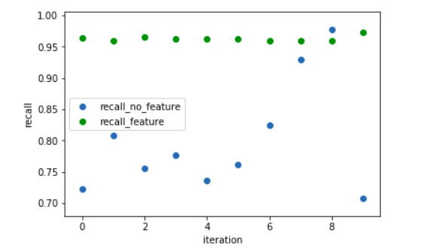
Comparison: dataset with feature and original dataset

Slide 18
Experiment Results: Attack 1,2,4,8,16
Table: comparing detection performance of each attack with other methods
 | attack 1 |  |  | attack 2 |  |  | attack 4 |  |  | attack 8 |  |  | attack 16
 | SVM[2] | KNN[2] | Neural Net | SVM [2] | KNN [2] | Neural Net | SVM [2] | KNN [2] | Neural Net | SVM [2] | KNN [2] | Neural Net | SVM [2] | KNN [2] | Neural Net
CCR | 0.9452 | 0.9564 | 0.9907 | 0.7508 | 0.7543 | 0.6854 | 0.9463 | 0.9116 | 0.9825 | 0.9471 | 0.9177 | 0.9725 | 0.8173 | 0.8403 | 0.9647
Precision | 0.9521 | 1.000 | 1.0 | 0.5613 | 0.5729 | 0.0 | 0.9506 | 0.8149 | 0.9990 | 0.9627 | 0.8035 | 0.9955 | 0.7143 | 0.8162 | 0.985
Recall | 0.8328 | 0.8290 | 0.9702 | 0.1937 | 0.1788 | 0.0 | 0.8363 | 0.8860 | 0.9498 | 0.8253 | 0.8755 | 0.8908 | 0.4254 | 0.4636 | 0.891
*** Note that Neural network based
model could not detect attack 2
CCR: Correct Categorical Rate.
Precision
Recall
[2] S. So, P. Sharma, and J. Petit, “Integrating Plausibility Checks and Machine Learning for Misbehavior Detection in
VANET,” presented at the 2018 17th IEEE International Conference on Machine Learning and Applications (ICMLA), pp. 564–571.

Slide 19
Experiment Results: Overall Attack
Table: comparing overall detection performance with other methods
 | SVM | KNN | Neural Net
CCR | 0.8788 | 0.8838 | 0.9244
Precision | 0.8879 | 0.8716 | 0.9948
Recall | 0.6166 | 0.6515 | 0.7868

Slide 20
Part 2, Attack Type Classification

Slide 21
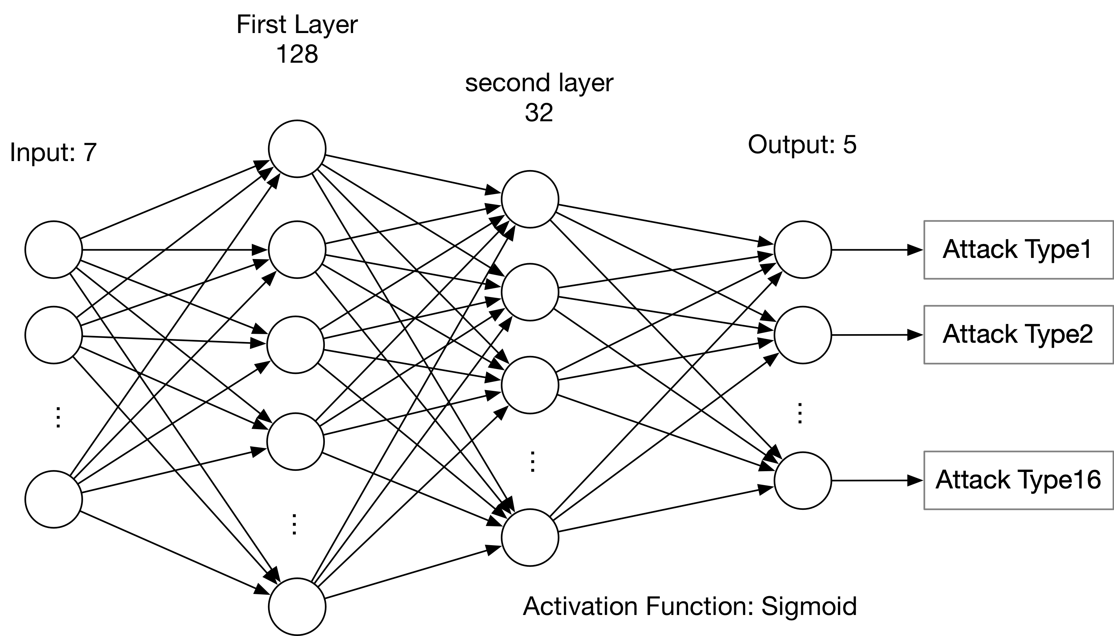
Fig: structure of neural network based classifier.
Classification Model

Slide 22
Classification Results
Table: results of classification accuracy
 |  | Prediction
 |  | Type 1 | Type 2 | Type 4 | Type 8 | Type 16
Ground truth | Type 1 | 0.7623 | 0.0212 | 0.0779 | 0.0191 | 0.1145
 | Type 2 | 0.0016 | 0.9401 | 0.0096 | 0.0444 | 0.0043
 | Type 4 | 0.0005 | 0 | 0.9909 | 0.0068 | 0.0018
 | Type 8 | 0 | 0.0458 | 0.0040 | 0.9259 | 0.0243
 | Type 16 | 0.2707 | 0.0620 | 0.0344 | 0.0450 | 0.5879
***Note that it is invalid for Type 2 attacker, because the first step, i.e. identifying whether the session
is malicious or does not success.

Slide 23
Model Test

Slide 24
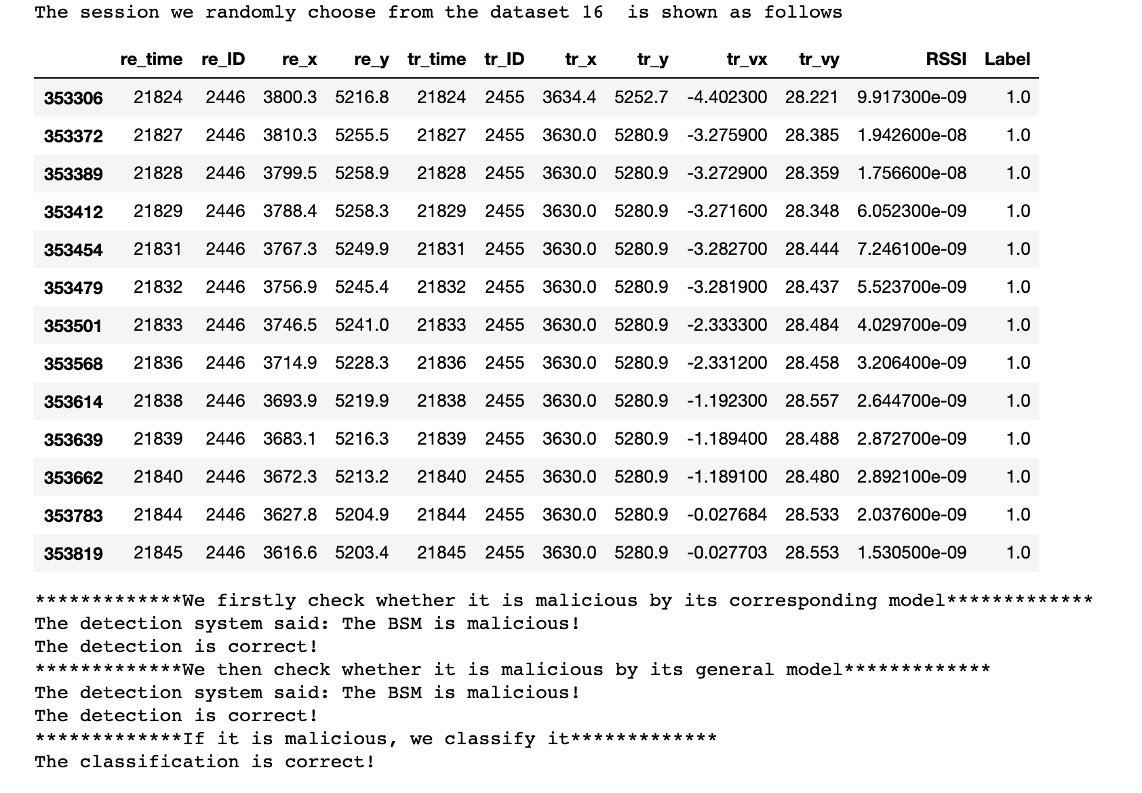
Test Model

Slide 25
Conclusion

Slide 26
Conclusion
Compared with existed literature, Neural Network based detector perform better than other method, e.g. SVM, KNN.
“Constant offset” attack could not be detected by the proposed model.

Slide 27
Thanks!

